Slide 1
Dynamic Block
Ow

Slide 2
What is dynamic block?
Within top-level block constructs like resources, expressions can usually be used only when assigning a value to an argument using the name = expression form.
This covers many uses, but some resource types include repeatable nested blocks in their arguments, which typically represent separate objects that are related to (or embedded within) the containing object

Slide 3
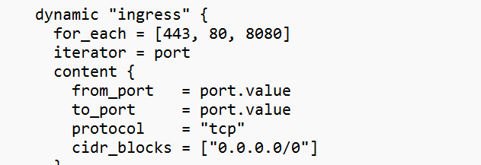
..
A dynamic block acts much like a for expression, but produces nested blocks instead of a complex typed value.
It iterates over a given complex value, and generates a nested block for each element of that complex value.

Slide 4
..
dynamic "ingress": This declares a dynamic block named "ingress." The purpose of using a dynamic block is to create multiple instances of a nested block with different configurations. In this case, it's used to dynamically create multiple ingress rules for different ports.
for_each = [443, 80, 8080]: This line specifies the set of values for which the dynamic block will iterate. It means that the block inside will be instantiated three times, once for each value in the list (443, 80, 8080).

Slide 5
..
iterator = port: This line sets the iterator variable to represent each element of the set during iteration. The name "port" is an arbitrary identifier that you can use within the dynamic block.
content { ... }: This is the content of the dynamic block. It defines the configuration for each iteration.
from_port = port.value: The from_port attribute is set to the current value of the iterator variable port. This represents the starting port of the ingress rule.
to_port = port.value: The to_port attribute is also set to the current value of the iterator variable port. This represents the ending port of the ingress rule. In this configuration, both from_port and to_port are the same, indicating a single port.

